Slide 1
PhonePe Transaction Insights Dashboard
SILVIYA X

Slide 2
Problem Statement:
With the rapid growth of digital payment platforms like PhonePe, analyzing transaction, user and insurance is essential to understand digital adoption trends across India. This project aims to build a dashboard using PhonePe Pulse data to visualize transaction growth, user engagement, insurance performance, and state-wise digital payment activity.
The dashboard helps identify top-performing states, analyze user and transaction patterns, monitor insurance adoption, and generate meaningful insights that support data-driven decision-making in India's digital payment ecosystem.
Objective:
Analyze PhonePe transaction trends across India.
Study user growth and digital payment adoption.
Evaluate insurance usage and growth patterns.
Visualize state-wise transaction and user distribution.
Identify top-performing states and regions.
Generate meaningful business insights from PhonePe Pulse data.

Slide 3
Dataset Description
PhonePe Pulse open-source dataset
Aggregated transaction data (count & amount)
User data (registered users & device brands)
Insurance data (count & amount)
State, district, and pin-code level data
Year-wise and quarter-wise records
Technology Stack
Python
Streamlit (Dashboard UI)
SQLite (Database)
Pandas (Data processing)
Matplotlib / Seaborn (Graphs)
Plotly (Maps)

Slide 4
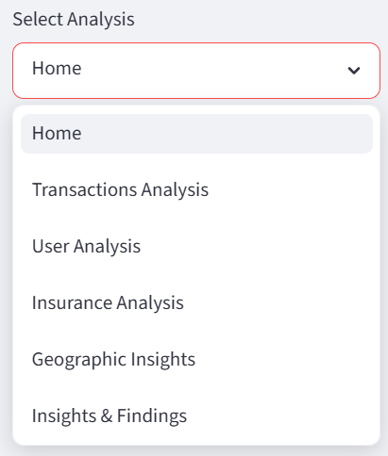
System Architecture:
PhonePe Dataset
↓
Data Extraction
↓
SQLite Database
↓
Streamlit App
↓
Visual Dashboard
↓
Insights Generation
Project Modules:
Home Page (KPIs + Overview)
Transactions Analysis
User Analysis
Insurance Analysis
Geographic Insights (Map)
Insights & Findings

Slide 5
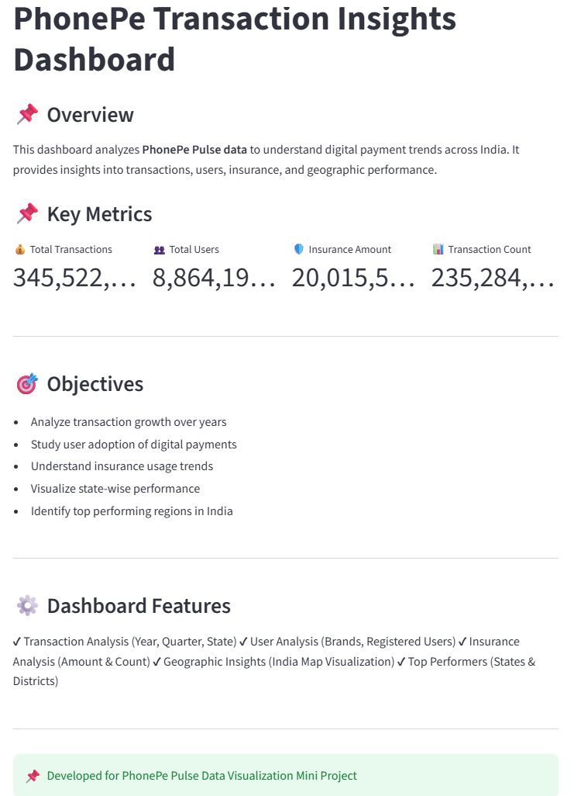
HOME PAGE
Home Page:
Displays key performance indicators (KPIs) of the PhonePe Pulse dataset.
Shows Total Transactions, Total Users, Insurance Amount, and Transaction Count.
Provides a quick overview of overall platform performance.
Acts as the starting point for exploring detailed analyses and insights.

Slide 6
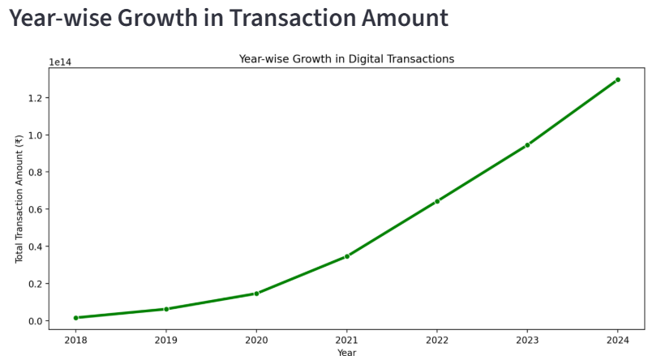
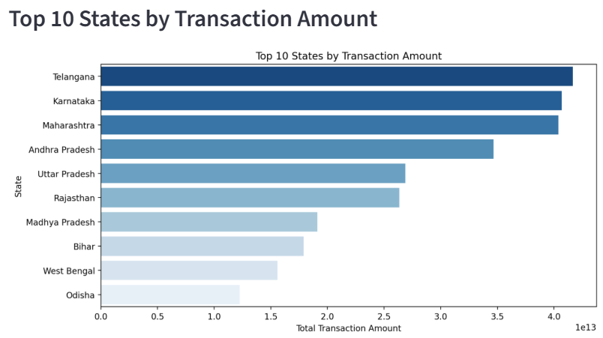
TRANSACTIONS ANALYSIS
This section analyzes transaction trends across India, including yearly growth, quarterly patterns, and top-performing states based on transaction amount.
Shows year-wise growth of transaction amount.
Displays top states by transaction volume.
Analyzes quarterly transaction trends.
Compares state-wise transaction performance.

Slide 7
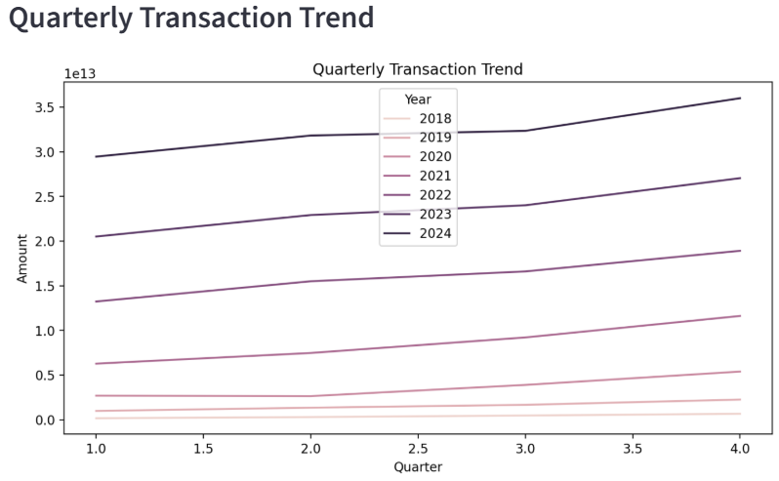
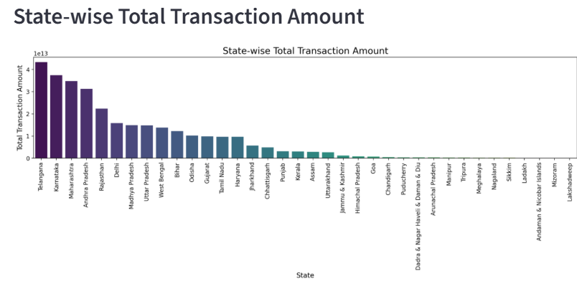
Key Insights:
Transactions are increasing every year, showing strong digital payment growth.
States like Maharashtra, Karnataka, and Maharashtra dominate in transaction volume.
Quarterly trends show higher usage in festive seasons (Q3 & Q4).
Overall, digital payments are steadily rising across India.

Slide 8
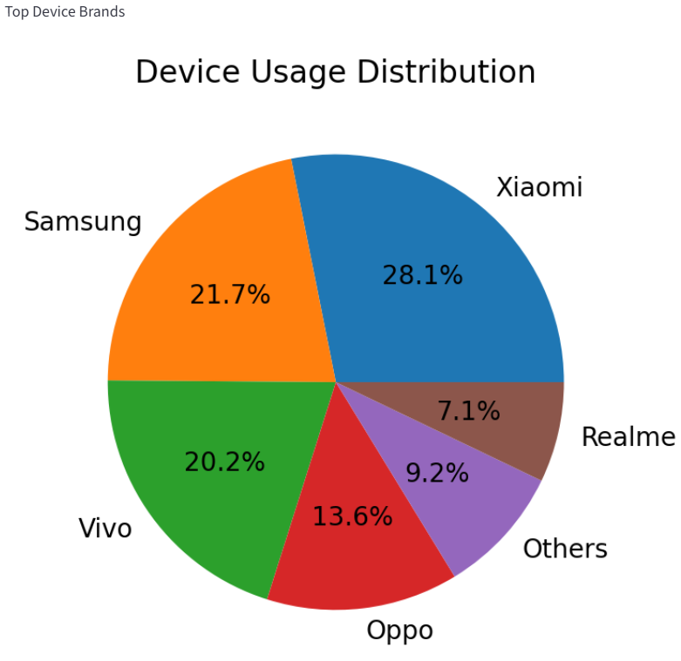
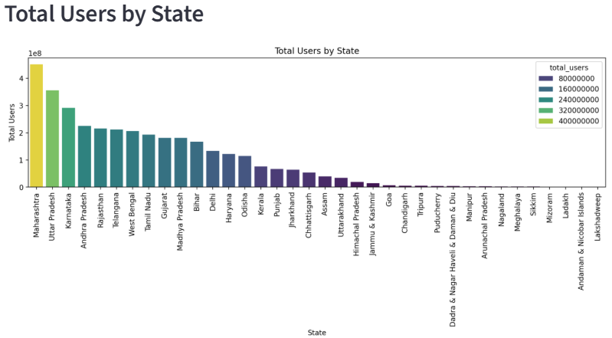
USER ANALYSIS
This section analyzes user growth, device usage, and state-wise adoption. It shows that users are increasing every year, with Android being the most used device and major states leading in adoption.
Shows state-wise total users distribution.
Displays device brand usage pattern.
Analyzes year-wise growth of registered users.
Compares user adoption across states.

Slide 9
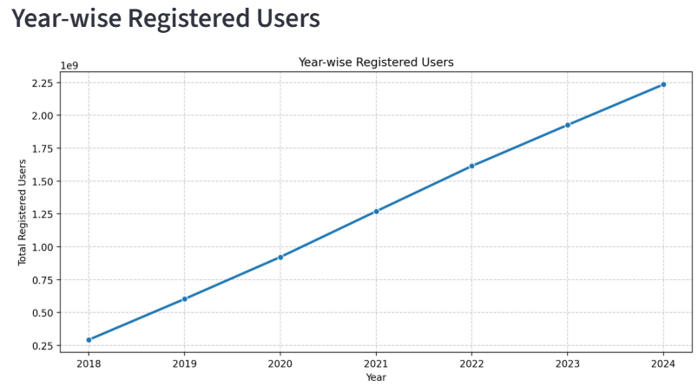
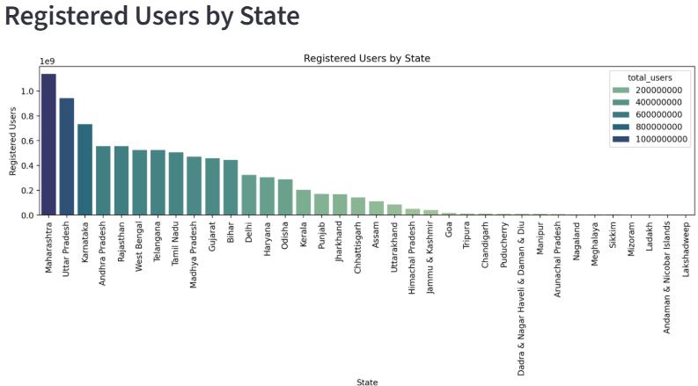
Key Insights:
User base is growing steadily every year.
Android devices dominate PhonePe usage.
States like Maharashtra, Karnataka and Uttar Pradesh have higher user adoption.
Urban states show faster digital payment adoption compared to rural regions.

Slide 10
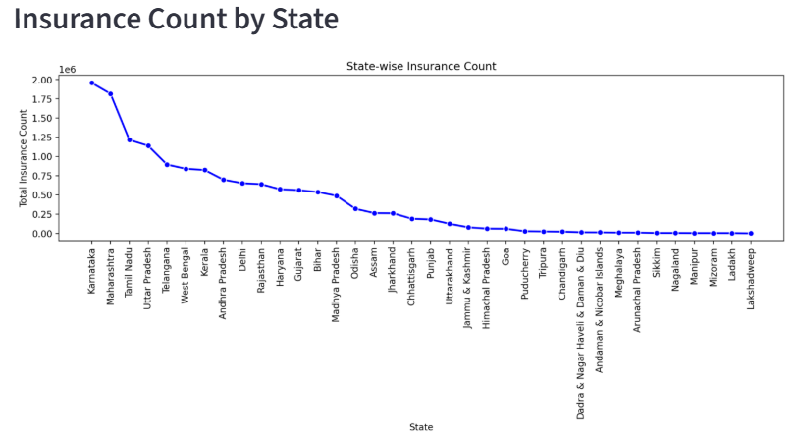
INSURANCE ANALYSIS
This section analyzes insurance trends, showing state-wise performance and growth over time. It highlights that insurance usage is still developing but gradually increasing.
Shows state-wise insurance count distribution.
Displays top states by insurance amount.
Analyzes year-wise insurance growth trends.

Slide 11
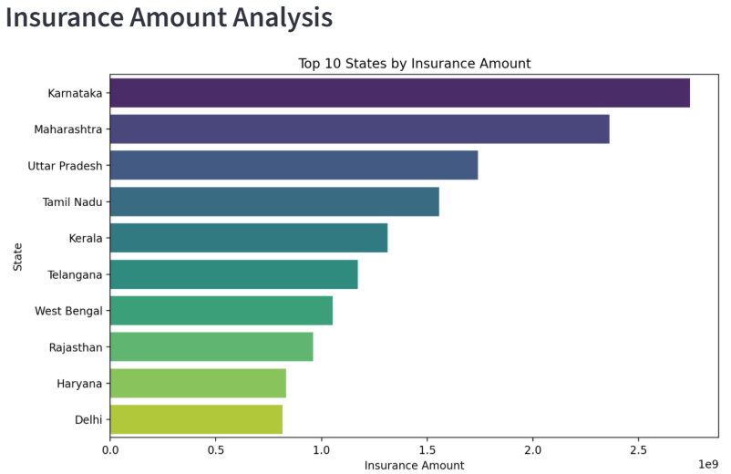
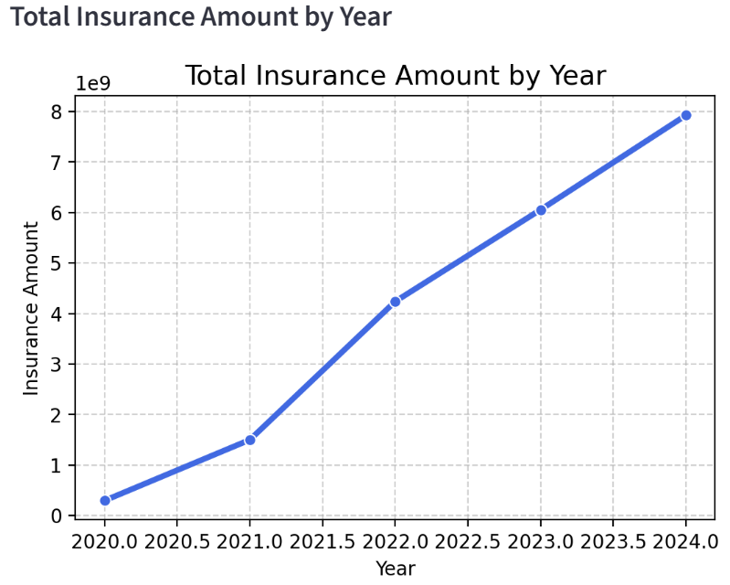
Key Insights:
Insurance usage is lower compared to transaction services.
Only a few states contribute majorly to insurance adoption.
Insurance transactions are gradually increasing over the years.
Awareness and adoption are still growing across India.

Slide 12
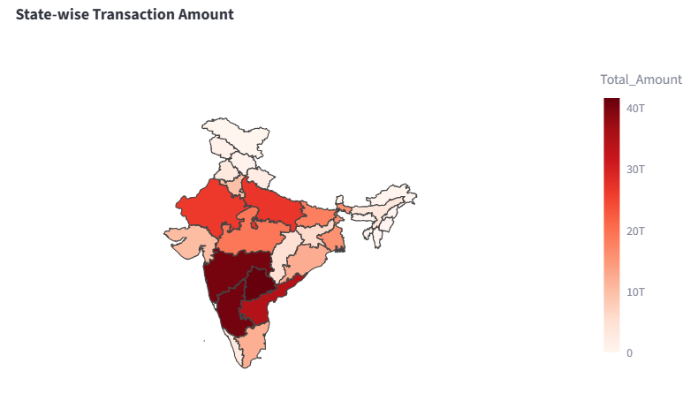
GEOGRAPHIC INSIGHTS
This section shows geographic distribution of transactions across India.
Key Insights:
Western and Southern states show higher digital transaction activity.
Northern and Northeastern regions have comparatively lower adoption.
Metro and urban regions contribute significantly to total transactions.
Digital payment usage varies widely across different states.

Slide 13
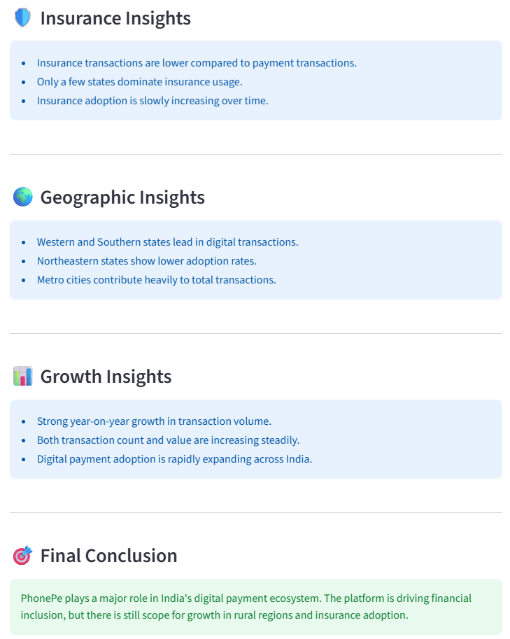
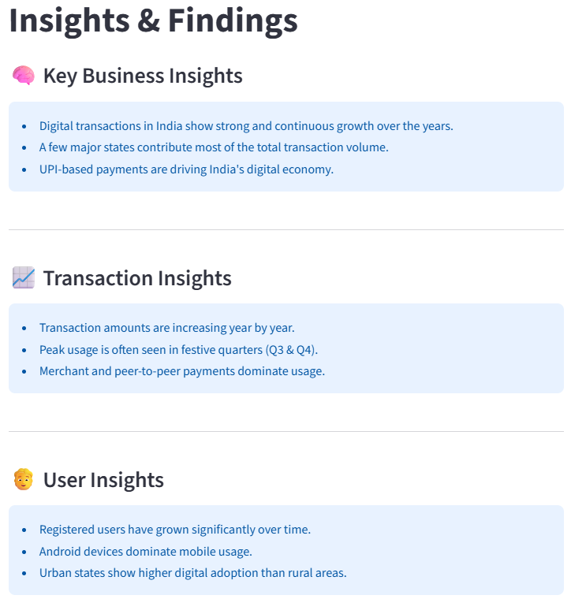
INSIGHTS & FINDINGS
This section summarizes the overall findings from the analysis. It shows strong growth in digital payments, major contributions from a few states, and increasing adoption across India.

Slide 14
Conclusion:
Successfully analyzed PhonePe Pulse dataset.
Built an interactive dashboard using Streamlit.
Visualized transactions, users, insurance, and geographic data.
Extracted meaningful business insights from the analysis.
Helped understand digital payment trends across India.
Thank You!

